Slide 1
Yancheng Huade （Dancheng）Biological Engineering Co., Ltd.
2022.07

Slide 2
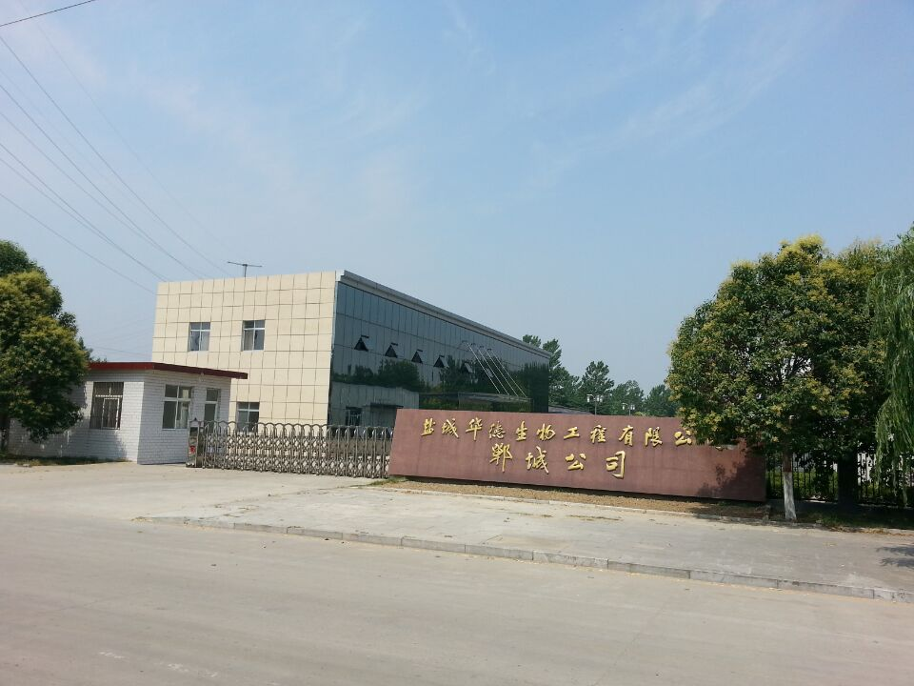
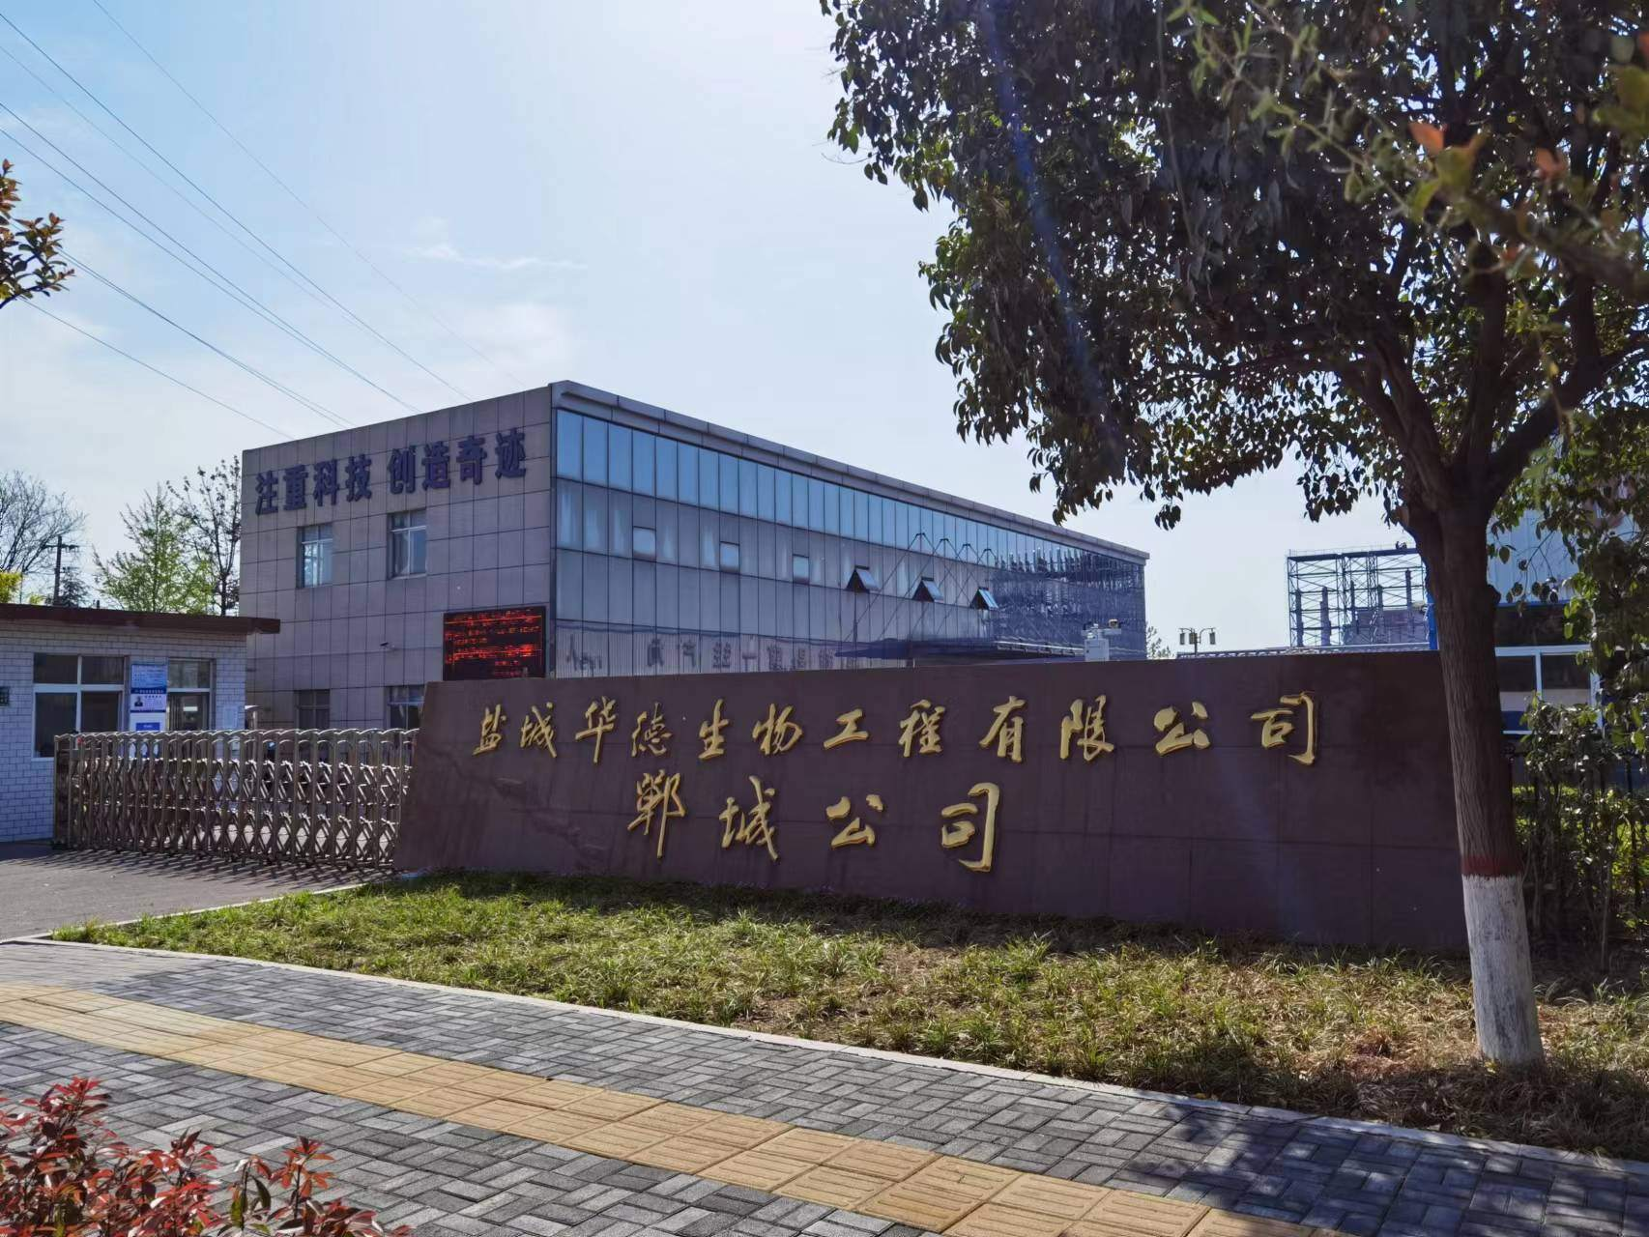

Slide 3
Contents
1
Corporate Philosophy
4
Company Organization
Company Organization
2
6
Performance presentation
Company Profile
5
Performance Presentation
7
3
Company Development
6
Company Vision

Slide 4
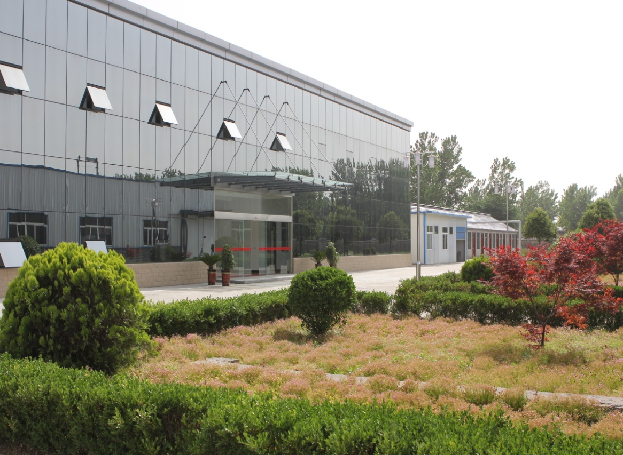
1、Corporate Philosophy
Product Refinement
Service Industrialization
Innovation Sustainability
Humanized Management

Slide 5
2、Company Profile
Corporate Name | Yancheng Huade Biological Engineering Co., Ltd. | Yancheng Huade （Dancheng）Biological Engineering Co., Ltd.
Establishment Time | 1991.7.16 | 2009.8.28
Legal representative | Yan Xizhong | Yan Dong
Staffs Number | 28 | 96
Registered capital | RMB1000000.00 | RMB2000000.00
Turnover | RMB250000000.00 (2021) | RMB250000000.00 (2021)
Address | Jianhu County, Yancheng City, Jiangsu Province (Headquarter) | Industrial Avenue, Chengdong Industrial Zone, Dancheng County, Zhoukou City, Henan Province (Factory)

Slide 6
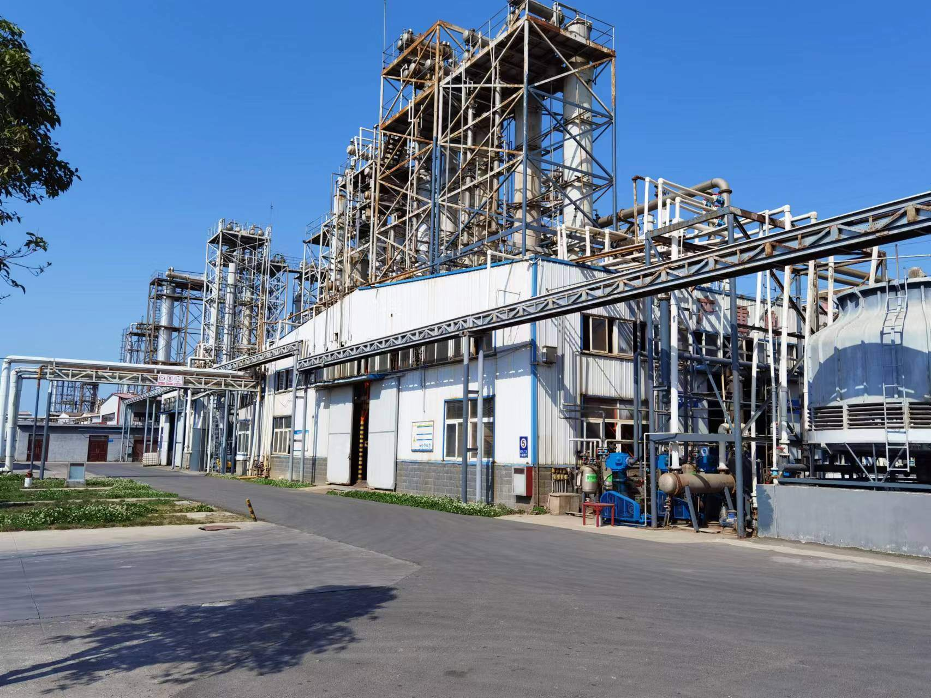
2、Company Profile
Yancheng Huade Biological Engineering Co., Ltd. was established in 1991. The company is located on the coast of the beautiful Yellow Sea, the hometown of the famous diplomat Qiao Guanhua - Jianhu County, Jiangsu Province. Yancheng Huade (Dancheng) Biological Engineering Co., Ltd. was established in 2009. The company is located in the Industrial Park of Dancheng County, Henan Province. This is the hometown of Lao Tzu, the founder of Taoism.
The company covers an area of 26,680 square meters. The company has 126 employees, including 30 technicians. The total assets are nearly 100 million yuan, of which fixed assets are more than 50 million yuan. Various types of testing equipment are fully equipped, which can meet the quality testing and control of the whole production process.

Slide 7

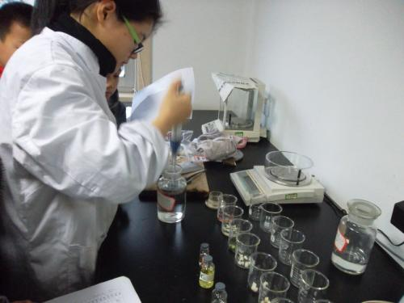
2、Company Profile
Advanced Production technology
Establish Cooperation
Quality Assurance
The company has always been adhering to the principle of "green environmental protection, caring for human beings", and is committed to developing environmentally friendly products.
Our company has been focusing on the research and development and production of lactic acid esters and lactic acid series products for more than 30 years (started in 1991), and the production technology of lactic acid esters and lactic acid products is the first in China.
Over the years, it has established good cooperative relations with many well-known enterprises at home and abroad. "Suixiang" brand products have been widely used in medicine, food, electronics, agrochemical, paint and other industries.
The quality system of the products is in The first among domestic counterparts to pass the ISO9001 international quality certification.

Slide 8
3、Company Development
1
Build a first-class team
2
Guarantee first-class quality
Development Goals
3
Provide first-class service

Slide 9
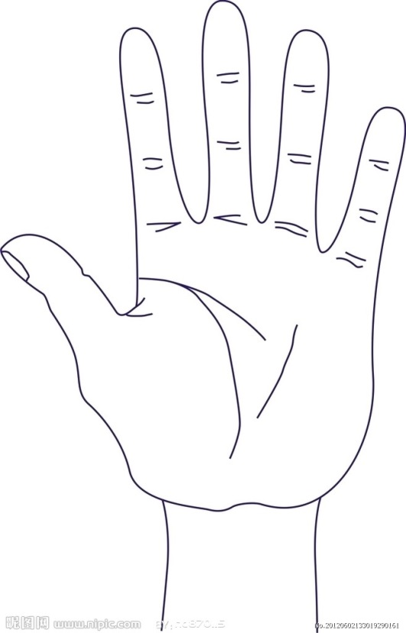
4、Company Organization
General Manager
Supply and Marketing
Department
Finance Department
Production Department
Quality Inspection
Department
Warehousing
Department
First workshop
Second workshop

Slide 10
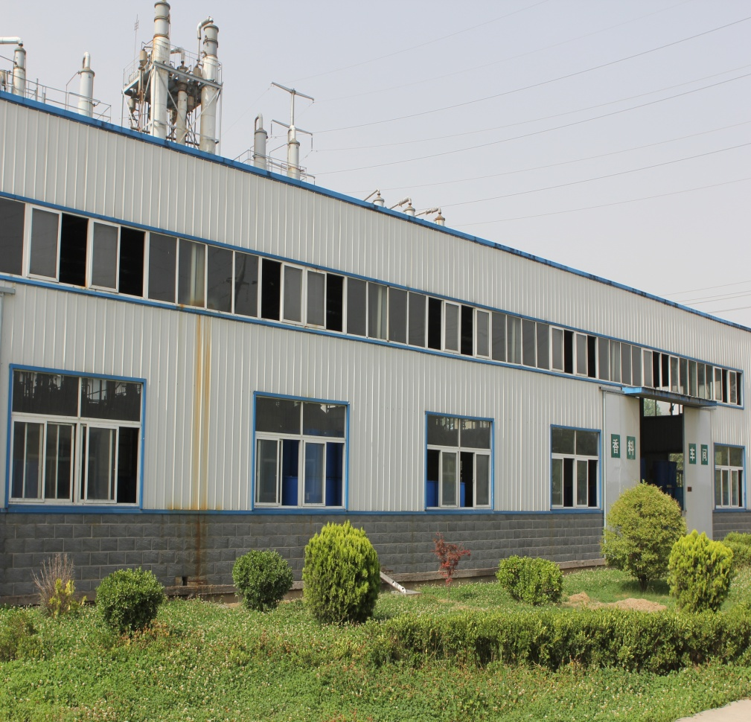
5、Performance presentation
Since the establishment of the company, the annual turnover has continued to increase.
From the perspective of business scope, the company's business has spread all over the world.
2021 sales of RMB 250 million.
Sales in 2022 are expected to reach 300 million yuan.

Slide 11

6、Company Vision
  Strives for the really practical development innovation.
  The future of Yancheng Huade (Dancheng) Bioengineering Co., Ltd. is brilliant and exciting!!!

Slide 12
THANKS
BOWENPPT

